Slide 1
GitHub Actions Workflow & Best Practices
Vikash Verma

Slide 2
GitHub Actions Workflow & Best Practices
1. Workflow YAML Syntax
Workflows: Defined in .github/workflows/<workflow-name>.yml
Key Sections:
name: Workflow name
on: Events that trigger workflow (e.g., push, pull_request)
jobs: A set of steps grouped together
runs-on: Environment (e.g., ubuntu-latest)
steps: Commands/actions to execute

Slide 3
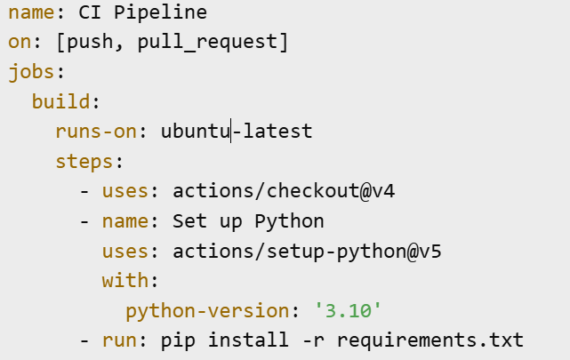
Example

Slide 4
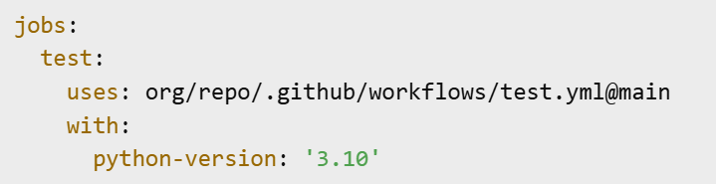
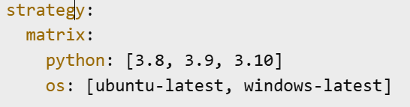
Re-usable Jobs & Matrix
Re-usable Jobs:
Allows defining workflows as templates to be called by others
Useful for consistent CI/CD across repositories
Matrix Strategy:
Runs jobs in parallel for multiple environments

Slide 5
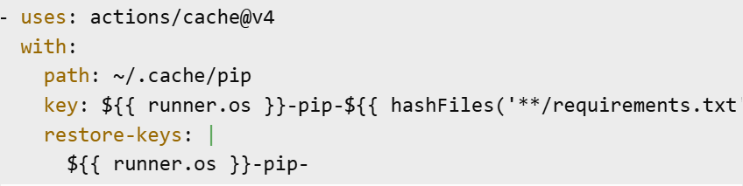
Cache pip Wheels
Why: Avoid reinstalling dependencies each run
Example:

Slide 6
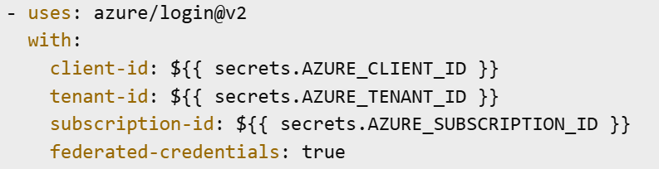
OIDC Azure Login
Purpose: Authenticate with Azure without storing secrets
Steps:
Configure Azure to trust GitHub’s OIDC tokens

Slide 7
Branch Protection Rules
Enforce code quality & security:
Require pull request reviews before merge
Require status checks to pass
Require signed commits
Prevent force pushes and deletions
Settings:
Go to Settings → Branches → Add Rule

Slide 8
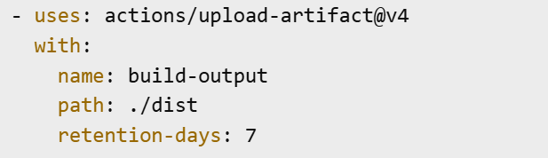
Artefact Retention
Purpose: Store build/test artefacts for later use
Example:
Default retention: 90 days, configurable per upload

